Slide 1
Dr Gitsham Creative Writing Elective
Lesson Three:
Writing Activities – What’s their story?
www.paulgitsham.com
@dcijoneswriter
© Paul Gitsham 2013 – Free for non-commercial use

Slide 2
On the following slides, you will be shown a photograph
First – Answer the following questions
Who are they?
Why are they there?
What are they thinking?
What are they doing?
How did they get here?
What is their story?
Write a short story about this photograph – be as imaginative as you like. Try and include as many of those details as you can in an unobtrusive way.

Slide 3
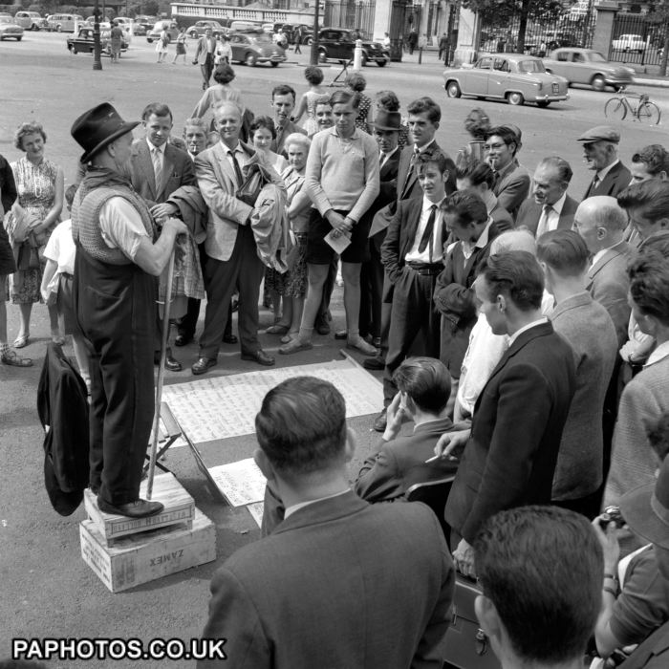
Who are they?
Why are they there?
What are they thinking?
What are they doing?
How did they get here?
Image Credit
http://www.assetstorage.co.uk/AssetStorageService.svc/GetImageFriendly/721382718/700/700/0/0/1/80/ResizeBestFit/0/PressAssociation/D278E2EE5E08B3CC36C67260A3372F4B/london-street-scenes.jpg

Slide 4
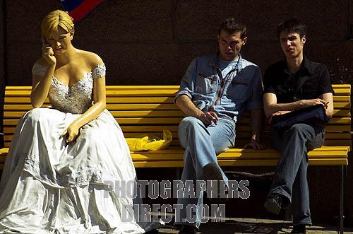
Who are they?
Why are they there?
What are they thinking?
What are they doing?
How did they get here?
Image Credit
http://img3.photographersdirect.com/img/9204/wm/pd811571.jpg

Slide 5
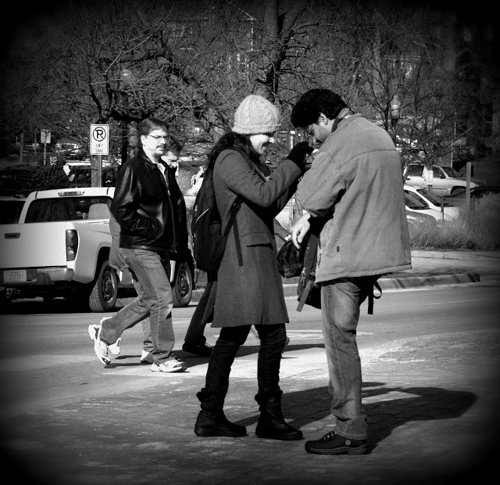
Who are they?
Why are they there?
What are they thinking?
What are they doing?
How did they get here?
Image Credit
http://1.bp.blogspot.com/-mojurCyrSMM/TxTPosjXUKI/AAAAAAAAQWw/fjEFqyCURL8/s1600/P1040120.JPG

